Slide 1
06 | Writing Help
Jeffrey Snover | Distinguished Engineer & Lead Architect
Jason Helmick | Senior Technologist, Concentrated Technology

Slide 2
Module Overview
Why you should provide help
Where so you put help?
Using Comment based help

Slide 3
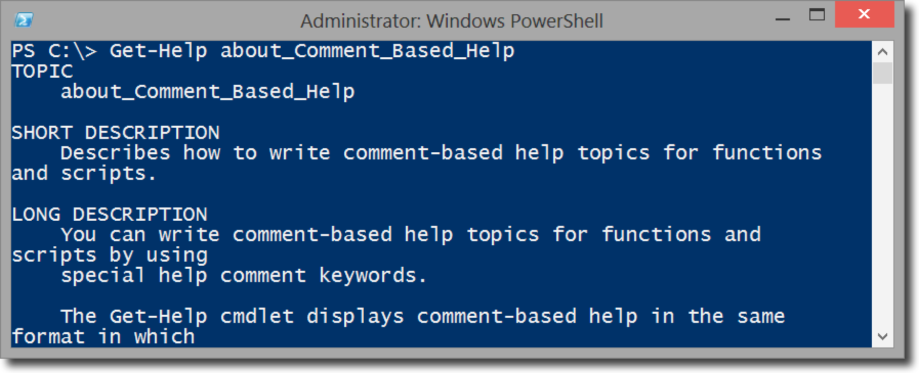
Why should add help
Admins expect the same behavior as cmdlet’s
Easy to do
Details in Get-Help About_Comment_Based_Help

Slide 4
Where do you put help?
Comment based help is the easiest to write for the IT Pro
Works for your scripts and functions
3 locations to place help
At the beginning of the function body
At the end of the function body
Before the function keyword
Careful with the blank lines!

Slide 5
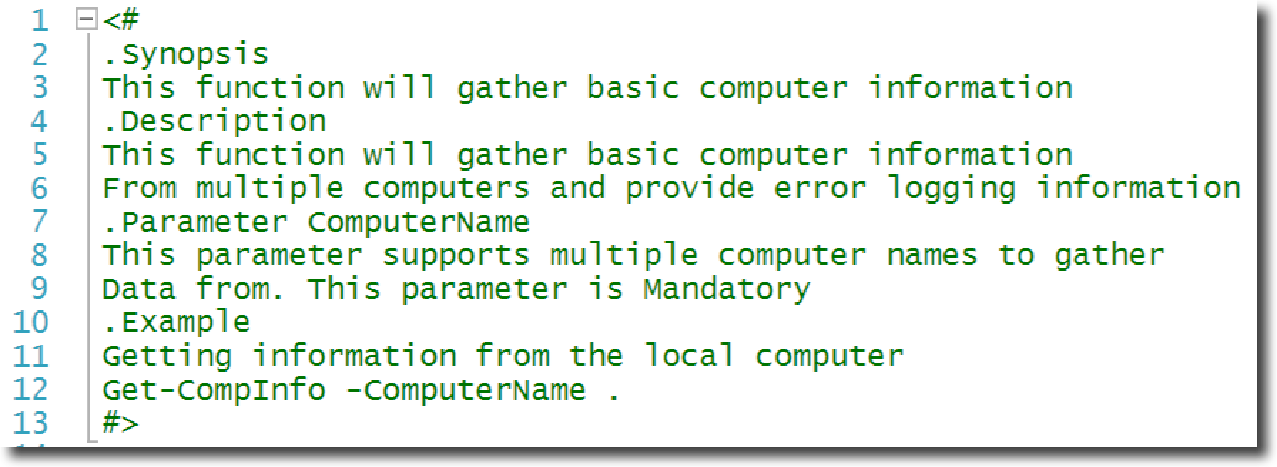
An Example of Comment Based Help
Get-Help About_Comment_Based_Help

Slide 6
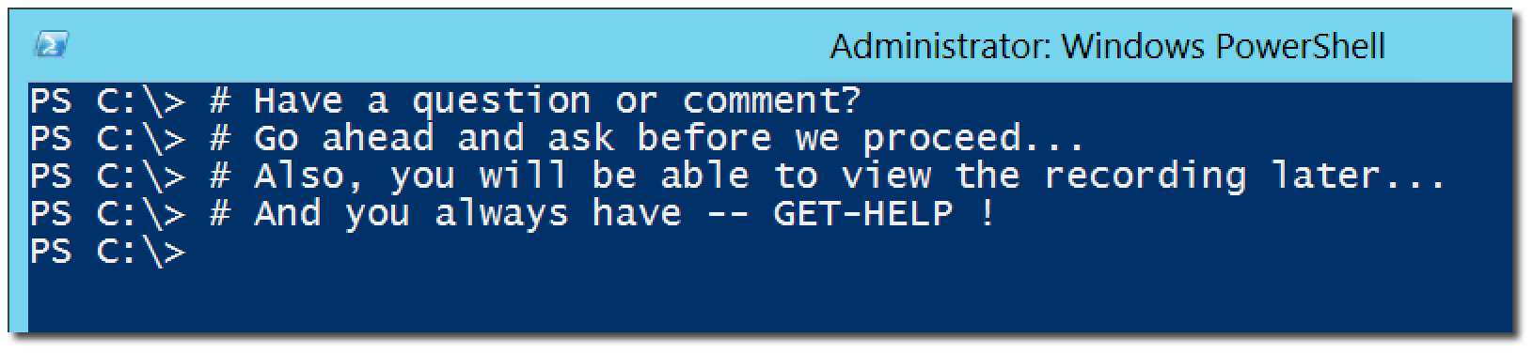
Questions or comments?

